Slide 1
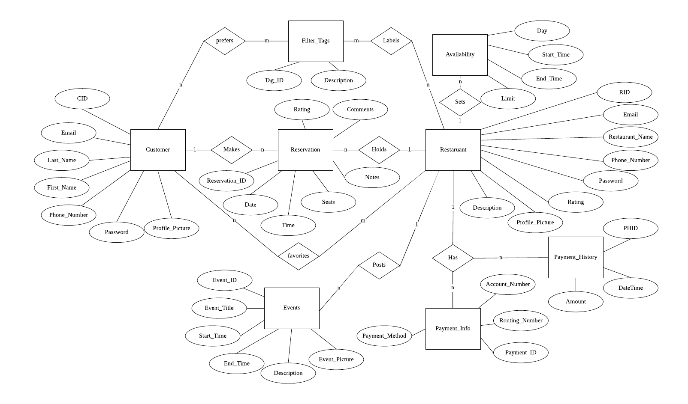
Conceptual database diagram

Slide 2
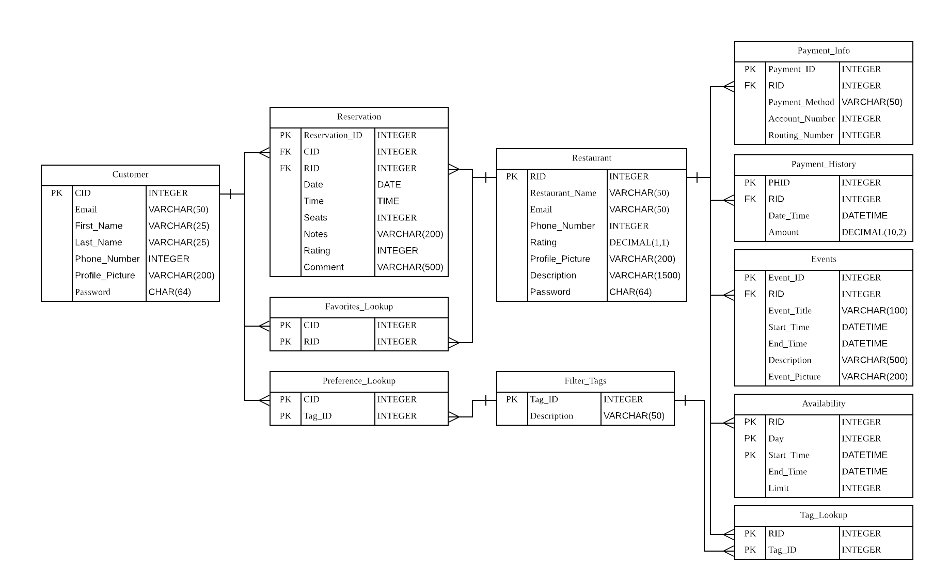
Logical database diagram
Notes:
Restaurant address
Instead using first name and last name should we use username instead
What is availability
Add open hour to restaurant??

